Slide 1
Parkview Lobby Redesign
A PBIS Building Culture Project

Slide 2
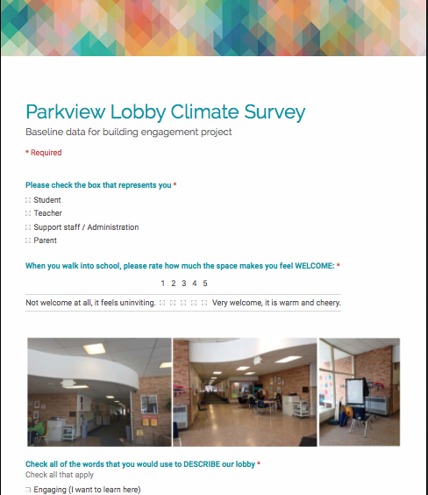
Baseline Data
In the Spring of 2015, a survey was collected among Parkview teachers, parents, and students measuring their perspective of the following:
How WELCOME does the lobby make you feel?
How well does the lobby REPRESENT Parkview
How PROUD do you feel about our lobby upon entering it
How well does the lobby provide INFORMATION?

Slide 3
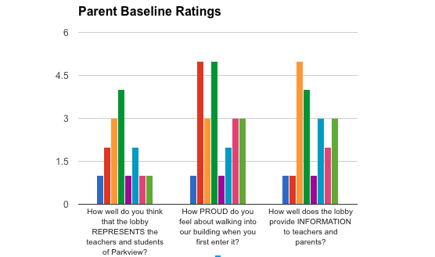
Results
Most parents rated the lobby to be informative, to evoke pride, and to well represent the building at a score of three or lower.

Slide 4
Results
STUDENT REPORT:
Students were inventoried with variable ratings. The below submitted quote illustrates a first impression of the lobby.
“I remember when I was new to the school and it was late in 2nd grade. I felt a little uncomfortable and really weird. Right when I walked in it didn't feel right, like it was not as comfortable as my other school. I think I would like the lobby a lot if you made it way more comforting and bigger.

Slide 5
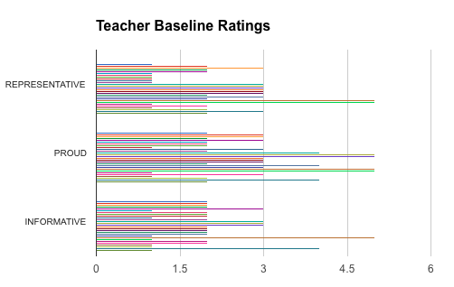
Results
RESULTS
Over 24 staff responses yielded a mean response of 2 in areas of the lobby’s evoking of pride, information, and representation of the building.

Slide 6
IMPLICATIONS
Student culture and school environmental research indicates that student pride and engagement are linked to their impression of their surroundings. Specific colors and visual organization promote an enhanced sense of belonging and improved positive behavior culture.
The results from the Lobby survey consistently identified the following description of Parkview’s present lobby space: Distracting (I have a hard time focusing), Unorganized (things are everywhere), Outdated (materials are old and worn), Boring, Ugly.

Slide 7
Action Steps towardS IMprovement
In the Spring of 2015 Parkview’s administration, PBIS committee, and BLT engaged in a student learning project with the Columbus College of Art and Design. The following recommendations and story boards were created with the goal of execution of redesign by October of 2015.

Slide 8
Action Step: Interior Paint

Slide 9
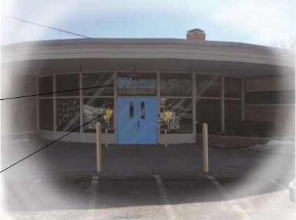
Action Step: EXTERIOR PAINT

Slide 10
Action Step: Community Learning garden

Slide 11
Action Step: Signage wall and Parent Waiting area

Slide 12
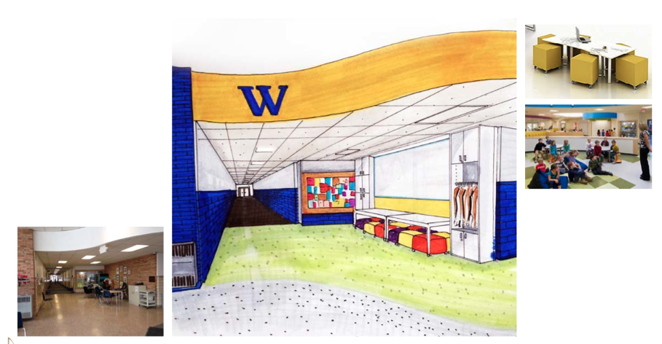
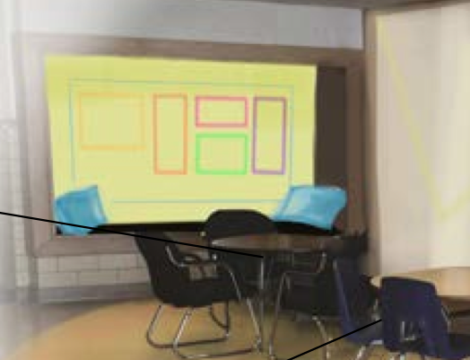
Action Step: Student learning space and Generals Club

Slide 13
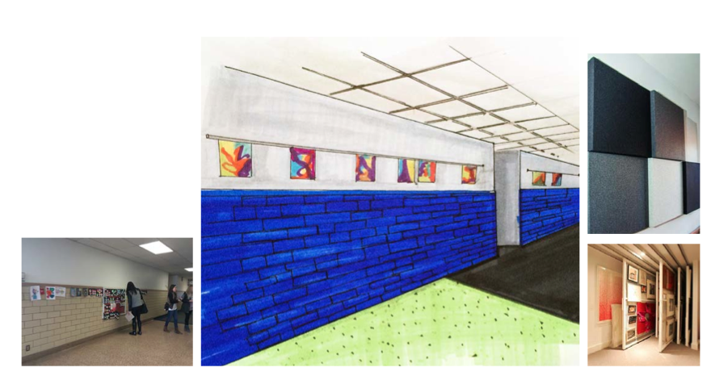
Action Step: STUDENT ART WORK SHOWCASE

Slide 14
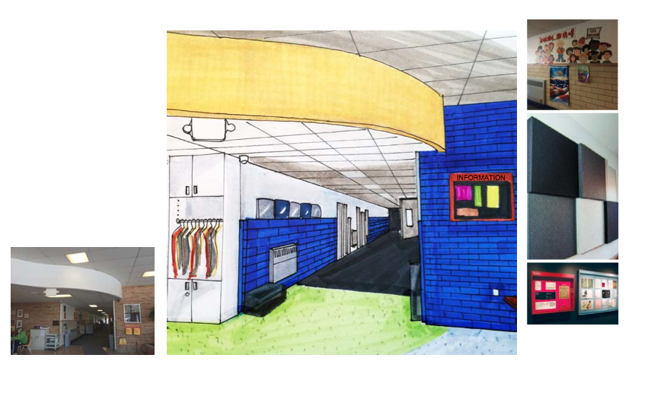
Action Step: PARENT COAT CLOSET & INFORMATION ZONE

Slide 15
HOW CAN YOU HELP?
If you are interested in helping with the redesign, we are in need of the following jobs completed on October 3rd:
Putting together furniture
Painting
Planting flowers
Building furniture
If you would like to help prior to October 3rd, we need people to:
Sew pillows and cushions
Locate past students showcasing artwork in the lobby
Contact local greenhouses to inquire about donations

Slide 16
HOW CAN YOU HELP?
A sign up link will be sent out next week to teachers, parents, and community members soliciting their help for the above. Please complete the link to participate.
Please see Sara Reith, Sara Crooks, or a member of your BLT with additional questions or to offer suggestions about the redesign.

